Slide 1
Romania – Republic of Serbia IPA Cross-border Cooperation Programme
Programming Languages
Lecturer: lect. dr. eng. Razvan BOGDAN
Notes:
Slide 1: Hello everyone and welcome to programming languages course.

Slide 2
Programming Languages
Lecture 6
Strings and Files
Notes:
Slide 2: In this lecture we are going to talk about Strings and files.

Slide 3
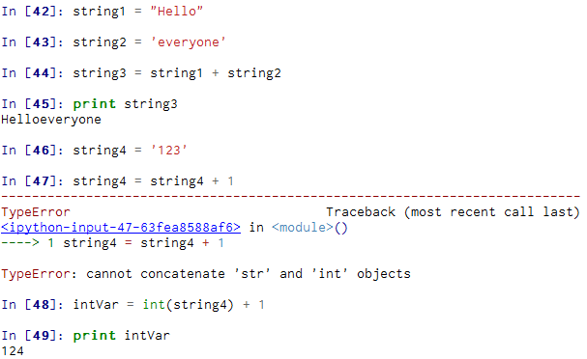
String Data Type
A string is a sequence of characters
A string literal uses quotes 'Hello' or “Hello”
For strings, + means “concatenate”
When a string contains numbers, it is still a string !!
We can convert numbers in a string into a number using int()
Notes:
Slide 3: String Data Type:
A string is a sequence of characters. You can use either use single quotes or double quotes in Python to delimit a string. So we will consider as example two strings. The first string, string1 will be Hello and the second is everyone. We can concatenate them together with a plus sign in another variable, let’s call it string3. After that we printed this variable and observed the result of concatenation. Please notice that there is no space between the two strings since we did not have a space in the first two strings.
It’s important to understand that if we have a string which is containing an integer, than we cannot perform mathematical operations with that string, like addition, subtraction and so on. That IS a string. So let’s take another string which contains 123; if we want to add 1 to this string, then we obtain a TypeError stating that we cannot concatenate 'str' and 'int' objects. But we would convert that to an integer using the int function that's built in and then we can add 1 to it, and the result will be 124.

Slide 4
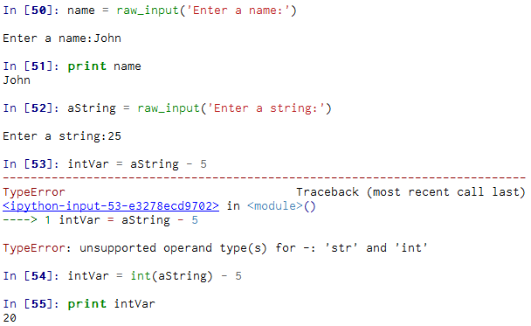
Reading and Converting
We prefer to read data in using strings and then parse and convert the data as we need
This gives us more control over error situations and/or bad user input
Raw input numbers must be converted from strings
Notes:
Slide 4: Reading and Converting:
The raw_input function just takes a string and puts it in a variable. So if I take Hello, then the variable contains the string H-e-l-l-o. Even if we type numbers, that is a string. So just because I put 1 0 0 in, I still can't subtract 10. It will be a string. If I attempt to do something like that, then I will obtain a traceback stating that we have a TypeError: unsupported operand type(s) for -: 'str' and 'int‘. In our example, as string we introduced 25 and then we tried to subtract 5, therefore the traceback. What we can do is to convert the 25 string into int and then subtract an integer from it.

Slide 5
A string is a sequence
We can get at any single character in a string using an index specified in square brackets [ ]
The index value must be an integer and starts at zero
The index value can be an expression that is computed
b
a
n
a
n
a
[0]
[1]
[2]
[3]
[4]
[5]
>>> fruit = 'banana'
>>> letter = fruit[1]
>>> print letter
a
>>> n = 3
>>> letter1= fruit[n - 1]
>>> print letter1
n
Notes:
Slide 5: A string is a sequence:
You can access the characters in a string one at a time with the bracket operator. So let’s take an example; we are having a string variable, fruit, which contains the characters ‘banana’. We can see that the second statement extracts the character at index position 1 from the fruit variable and assigns it to letter variable. The expression in brackets is called an index. The index indicates which character in the sequence we want (hence the name). Now, for most people, the first letter of 'banana' is b, not a. But in Python, the index is an offset from the beginning of the string, and the offset of the first letter is zero. Therefore b is the 0th letter (“zero-eth”) of 'banana', a is the 1th letter (“one-eth”), n is the 2th (“two-eth”) letter and so on.

Slide 6
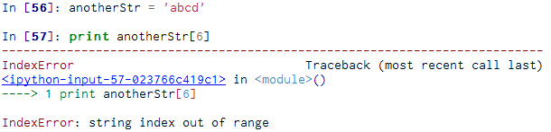
What if a character is too far?
You will get a python error if you attempt to index beyond the end of a string.
So be careful when constructing index values and slices
Notes:
Slide 6: What if a character is too far?:
You will get a python error if you attempt to index beyond the end of a string. So be careful when constructing index values and slices. In our example we had a variable called anotherStr which contains a string with 4 characters. So if we attempt to access a character which is not part of the string, we will receive IndexError: string index out of range.

Slide 7
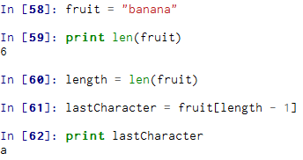
Getting the length of a string using len
There is a built-in function len that gives us the length of a string
To get the last character, you have to subtract 1 from the length
b
a
n
a
n
a
[0]
[1]
[2]
[3]
[4]
[5]
Notes:
Slide 7: Getting the length of a string using len:
In order to obtain the length of a string, there is a built-in function called len. So for our example, the banana string has 6 characters, so the len function will return 6. Since we started counting at zero, the six letters are numbered 0 to 5. So if we want to get the last character, we have to subtract 1 from length. Also, we can use negative indices, which count backward from the end of the string. The expression fruit[-1] offers the last letter, fruit[-2] yields the second to last, and so on.

Slide 8
Looping Through Strings (1)
Using a while statement and an iteration variable, and the len function, we can construct a loop to look at each of the letters in a string individually
fruit = 'banana'
index = 0
while index < len(fruit) :
letter = fruit[index]
print index, letter
index = index + 1
0 b
1 a
2 n
3 a
4 n
5 a
Notes:
Slide 8: Looping Through Strings (1):
A lot of computations involve processing a string one character at a time. Often they start at the beginning, select each character in turn, do something to it, and continue until the end. This pattern of processing is called a traversal. One way to write a traversal is with a while loop. This loop traverses the string and displays each letter on a line by itself. The loop condition is index < len(fruit), so when index is equal to the length of the string, the condition is false, and the body of the loop is not executed. The last character accessed is the one with the index len(fruit)-1, which is the last character in the string. (Charles Severance, Python for Informatics: Exploring Information)

Slide 9
Looping Through Strings (2)
A definite loop using a for statement is much more elegant
The iteration variable is completely taken care of by the for loop
fruit = 'banana'
for letter in fruit :
print letter
b
a
n
a
n
a
index = 0
while index < len(fruit) :
letter = fruit[index]
print letter
index = index + 1
Notes:
Slide 9: Looping Through Strings (2):
Another way to write a traversal is with a for loop, as we can see in the presented example. Each time through the loop, the next character in the string is assigned to the variable letter. The loop continues until no characters are left. So basically, the same result is obtained as with using an index variable, but this time the method is much more elegant because the iteration variable is completely taken care of by the for loop.

Slide 10
Looping and Counting
This is a simple loop that loops through each letter in a string and counts the number of times the loop encounters the 'a' character.
word = 'banana'
count = 0
for letter in word :
if letter == 'a' :
count = count + 1
print count
Notes:
Slide 10: Looping and Counting:
This is a simple loop that loops through each letter in a string and counts the number of times the loop encounters the 'a' character. This program demonstrates another pattern of computation called a counter. The variable count is initialized to 0 and then incremented each time an a is found. When the loop exits, count contains the result—the total number of a’s. (Charles Severance, Python for Informatics: Exploring Information)

Slide 11
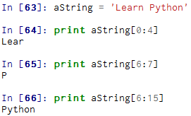
Slicing Strings
We can also look at any continuous section of a string using a colon operator [n:m]
The second number is one beyond the end of the slice - “up to but not including” (!!)
If the second number is beyond the end of the string, it stops at the end
L
e
a
r
n
P
y
t
h
o
n
0
1
2
3
4
5
6
7
8
9
10
11
Notes:
Slide 11: Slicing Strings:
A segment of a string is called a slice. Selecting a slice is similar to selecting a character and in this case we will be using the [n:m] colon operator. This returns the part of the string from the “n-eth” character to the “m-eth” character, including the first but excluding the last. If we omit the first index (before the colon), the slice starts at the beginning of the string. If you omit the second index, the slice goes to the end of the string.

Slide 12
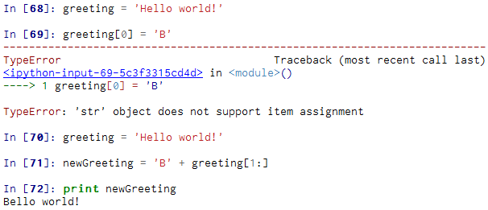
Strings are immutable
Strings are immutable, which means you can’t change an existing string
Notes:
Slide 12: Strings are immutable:
Strings are immutable, which means you can’t change an existing string. What you can do is to create a new string that is a
variation on the original. In the presented example you see how to concatenate a new first later in the original string called greeting.

Slide 13
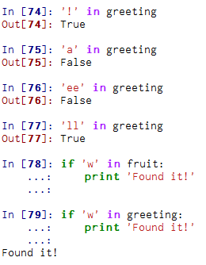
The in operator
The in keyword can also be used to check to see if one string is "in" another string
The in expression is a logical expression and returns True or False and can be used in an if statement
Notes:
Slide 13: The in operator:
The word in is a boolean operator that takes two strings and returns True if the first appears as a substring in the second. In the presented examples you can see that even multiple characters can be searched out in a string, like is the case of ll in variable greeting.

Slide 14
String Comparison
if word == ‘hello':
print ‘It is hello.'
if word < ‘hello':
print 'Your word,' + word + ', comes before hello.’
elif word > ‘hello':
print 'Your word,' + word + ', comes after hello.’
else:
print ‘The default: hello.'
Notes:
Slide 14: String Comparison:
The comparison operators work on strings. To see if two strings are equal we can use the equal equal operator. Other comparison operations are useful for putting words in alphabetical order, as it is presented on the slide. You should know that Python does not handle uppercase and lowercase letters the same way that people do. All the uppercase letters come before all the lowercase letters. Therefore a common practice to address this issue is to convert strings to a standard format, such as all lowercase, before performing the comparison.

Slide 15
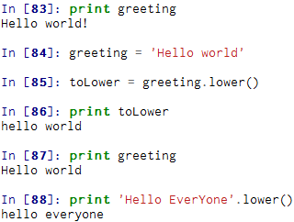
String Library (1)
Python has a number of string functions which are in the string library
These functions are already built into every string - we invoke them by appending the function to the string variable
These functions do not modify the original string, instead they return a new string that has been altered
Notes:
Slide 15: String Library (1):
Strings are an example of Python objects. An object contains both data (the actual string itself) as well as methods, which are effectively functions which that are built into the object and are available to any instance of the object. Python has a number of string functions which are in the string library. These functions are already built into every string, therefore we invoke them by appending the function to the string variable.
What is very important to notice is that these functions do not modify the original string, instead they return a new string that has been altered. (Charles Severance, Python for Informatics: Exploring Information)
So please notice the example, where the original greeting string was modified because when print again that string we can see that it was not altered in any way.

Slide 16
String Library (2)
>>> aString= 'Hello world’
>>> type(aString)
'str'
>>> dir(aString)
['capitalize', 'center', 'count', 'decode', 'encode', 'endswith', 'expandtabs', 'find', 'format', 'index', 'isalnum', 'isalpha', 'isdigit', 'islower', 'isspace', 'istitle', 'isupper', 'join', 'ljust', 'lower', 'lstrip', 'partition', 'replace', 'rfind', 'rindex', 'rjust', 'rpartition', 'rsplit', 'rstrip', 'split', 'splitlines', 'startswith', 'strip', 'swapcase', 'title', 'translate', 'upper', 'zfill']
http://docs.python.org/lib/string-methods.html
Notes:
Slide 16: String Library (2):
Python has a function called dir that lists the methods available for an object. The type function shows the type of an object and the dir function shows the available methods. You can also get help by using the help command or even the official Python documentation for string methods at the link from the slide.
Calling a method is similar to calling a function—it takes arguments and returns a value—but the syntax is different. We call a method by appending the method name to the variable name using the period as a delimiter. A method call is called an invocation. (Charles Severance, Python for Informatics: Exploring Information)
Let’s take some examples of using a few of such methods.

Slide 17
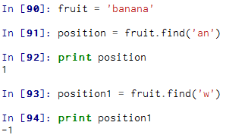
Searching a String
We use the find() function to search for a substring within another string
find() finds the first occurrence of the substring
If the substring is not found, find() returns -1
Remember that string position starts at zero
b
a
n
a
n
a
[0]
[1]
[2]
[3]
[4]
[5]
Notes:
Slide 17: Searching a String:
First of all we would like to search for a particular substring in a string. For this, Python provides the find() function. find() finds the first occurrence of the substring, if the substring is not found, find() returns -1. In this example, we invoke find on word and pass the letter we are looking for as a parameter. But we can also search after an entire substring as it can be seen on line [91] of out example.

Slide 18
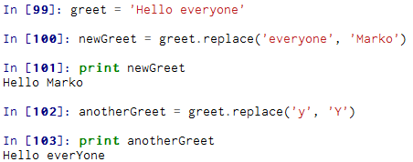
Search and Replace
The replace() function is like a “search and replace” operation in a word processor
It replaces all occurrences of the search string with the replacement string
Notes:
Slide 18: Search and Replace:
Another example is the usage of replace() method which acts like a “search and replace” operation in a word processor: It replaces all occurrences of the search string with the replacement string. In the code starting on line [99] on the slide, we see that we are having a string variable and then we want to replace a certain word with another substring which is offered as a second parameter to the replace function. But we can also replace only a single character as you can see on lines [102] and [103]

Slide 19
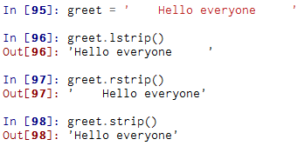
Stripping Whitespace
Sometimes we want to take a string and remove whitespace at the beginning and/or end
lstrip() and rstrip() to the left and right only
strip() removes both begin and ending whitespace
Notes:
Slide 19: Stripping Whitespace:
Sometimes we want to take a string and remove whitespace at the beginning and/or end. For this we can use the built-in functions called lstrip and rstrip to remove the white space from the left or right of the string. There is also another method called strip which is removing the whitespaces both at begin and end of the string.

Slide 20
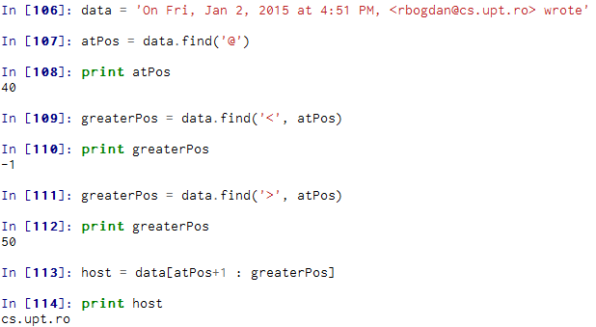
Parsing Strings
40
50
On Fri, Jan 2, 2015 at 4:51 PM, <rbogdan@cs.upt.ro> wrote
Notes:
Slide 20: Parsing Strings:
Sometimes we want to look into a string and find a substring. Suppose we have the string on the slide; so from that string we would like to extract only the host, which is cs.upt.ro. We can do this by using the find method and string slicing. First of all, we want to find the position of the at-sign in the string. Then we will find the position of the first greater sign after the at-sign (please note line [111] on the code example). After that we will use string slicing to extract the portion of the string which we are looking for.

Slide 21
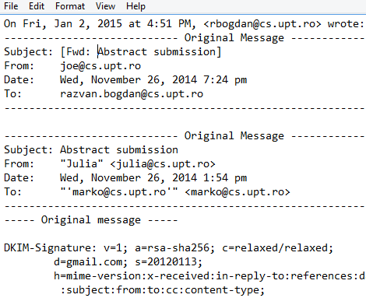
Files
A text file can be thought of as a sequence of lines
Notes:
Slide 21: Files:
OK! So far we have discussed about strings and different functions, we called them methods that can be applied on the strings. We even wrote our own methods that were inspecting the strings.
Now we will move to the second part of this lecture, namely the files where we will be using some of the techniques introduced when talking about strings.
So a file can be thought as a sequence of lines and we will primarily focus on reading and writing text files such as those we create
in a text editor. On the slide is such an example of a text file who is containing some email communication data.

Slide 22

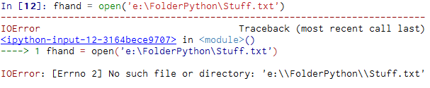
Opening Files
Before we can read the contents of the file we must tell Python which file we are going to work with and what we will be doing with the file
This is done with the open() function
open() returns a “file handle” - a variable used to perform operations on the file
handle = open(filename, mode)
Notes:
Slide 22: Opening Files:
When we want to read or write a file (for example on our hard drive), first of all we must open the file. Opening the file communicates with your operating system which knows where the data for each file is stored. In our example we are using a file called mailStuff.txt which is available on that particular folder, therefore we should provide the entire path for the open function. Now, if the file is stored in the same folder that you are in when you start Python, then the entire path is not required. open() is the built-in function which tells Python to open the file. open() takes two parameters 'filename' and 'mode'. If you leave the second parameter off 'open(filename)' Python will simply open the file in read mode ('r').
If the open is successful, the operating system returns us a file handle. The file handle is not the actual data contained in the file, but instead it is a “handle” that we can use to read the data. You are given a handle if the requested file exists and you have the proper permissions to read the file. If the file does not exist, open will fail with a traceback and you will not get a handle to access the contents of the file. (Charles Severance, Python for Informatics: Exploring Information)
The traceback is an input-output error stating that there is no such file or directory.

Slide 23
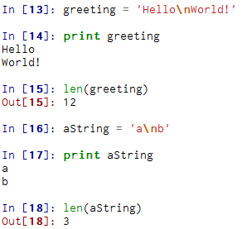
The newline Character
We use a special character to indicate when a line ends called the "newline"
We represent it as \n in strings
Newline is still one character - not two
Notes:
Slide 23: The newline Character:
To break the file into lines, there is a special character that represents the “end of the line” named the newline character.
In Python, we represent the newline character as a backslash-n in string constants. Even though this looks like two characters, it is actually a single character. So in our examples you can see that in the greeting variable there is a string Hello\nWorld. When we will print this string, the World characters will be listed on a new line due to the newline Character. We can prove that this character is actually a single character when we use the len function: a\nb shows that there are 3 characters and not 4.

Slide 24
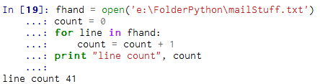
Code patterns (1)
Counting lines in a file
Notes:
Slide 24: Code patterns (1):
Let’s consider now some examples, or better called code patterns. For the beginning we would like to count the lines in a file. So for this we will be using a for loop where for every new line we will be incrementing a count variable.
The for loop actually causes the data to be read from the file. When the file is read using a for loop in this manner, Python takes care of splitting the data in the file into separate lines using the newline character. Python reads each line through the newline and includes the newline as the last character in the line variable for each iteration of the for loop. (Charles Severance, Python for Informatics: Exploring Information)

Slide 25
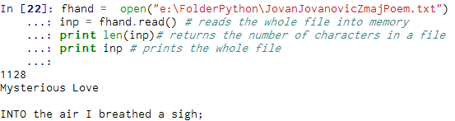
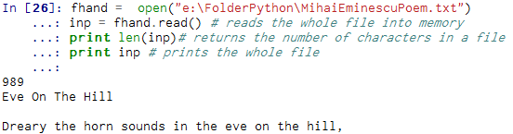
Code patterns (2)
Reading the whole file
Notes:
Slide 25: Code patterns (2):
Another code pattern is to read an entire file. So for this we will have an inp variable where we read the whole file. We just want to make see the number of characters in the file and in the end print the whole file by printing the inp variable. Due to space considerations in the two examples from the slide we have not listed the entire texts of the poems we took as examples: one from the Serbian poet Jovan Jovanovici Zmai and the other from the Romanian national poet, Mihai Eminescu. So enjoy in trying these examples. :)

Slide 26
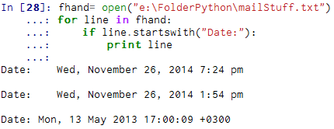
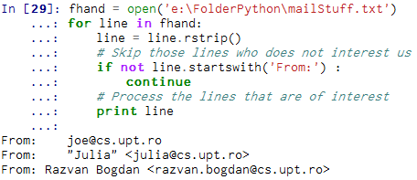
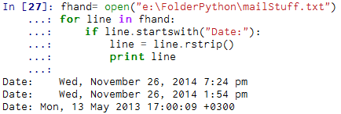
Code patterns (3)
Searching through a file
Notes:
Slide 26: Code patterns (3):
When you are searching through data in a file, it is a very common pattern to read through a file, ignoring most of the lines and only processing lines which meet a particular criteria. We can combine the pattern for reading a file with string methods to build simple search mechanisms. (after Charles Severance, Python for Informatics: Exploring Information)
For example, if we want to read a file and print only those lines that start with Date:, then we could use the string method startswith to select only those lines with the desired prefix. You can see on the example starting at line [28] that the output is printing the desired lines, but with some extra blank lines. Why is this possible? Well, because each lines finishes with an invisible newline character. Therefore we can optimize our program by removing these characters; we will use the rstrip method which strips whitespace from the right side of a string (see the dotted rstrip).
Sometimes is very useful to structure the programs by using continue; in this way whenever we find a line that is of interest to us, we want to do something with that line; when the line is of no interest to us, we skip it and go to the next one.

Slide 27
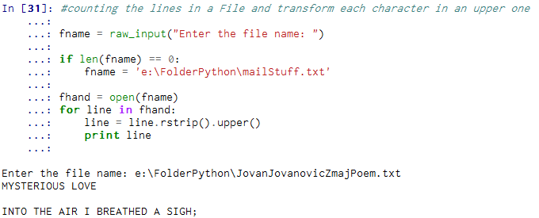
Letting the user choose the file name
Using raw_input()
Notes:
Slide 27: Letting the user choose the file name:
Whenever we want to prompt the user to introduce a file name, instead of hardcoding it into the program, we can use the built-in function raw_input() (see the dotted line). In the present example, if the user skips introducing the file name, then a default file name will be transmitted as parameter. After we eliminate the newline character, we transform all the characters in capital letters.

Slide 28
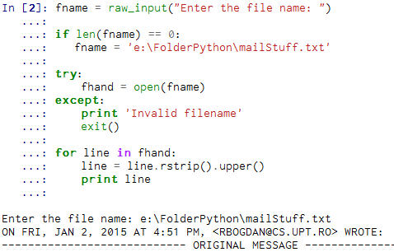
Using try, except, and open
Avoid bad file names
Notes:
Slide 28: Using try, except, and open:
What is the user types a wrong file name? As programmers, we are supposed to deal in our program with such a situation, therefore we must include a guardian, namely a try except structure. The try/except means to Py "try to open the file. In case the file cannot be opened, print invalid filename and kill the program". So here it is our previous example, but this time the open function is being placed inside a try/except structure. So if a bad file name is being provided, then we print a message and exit the program.

Slide 29
Homework
Search the python documentation and write a small program which is transforming all the characters in a string in uppercase.
Take the following Python code that stores a string:
aString = ‘The grade you took at exam: 9.9876'
Use find and string slicing to extract the portion of the string after the colon character and then use the float function to convert the extracted string into a floating point number.
3. For the mailStuff.txt file, parse the file and count how many times you find cs.upt.ro
Notes:
Slide 29: Homework: As homework, here are some exercises that you are invited to solve, based on your knowledge you have gained so far and especially during this course on strings and files. Also, try solving the examples presented in the course by working them out in Canopy. Good luck and thank you very much for watching this course! ☺

